Slide 1
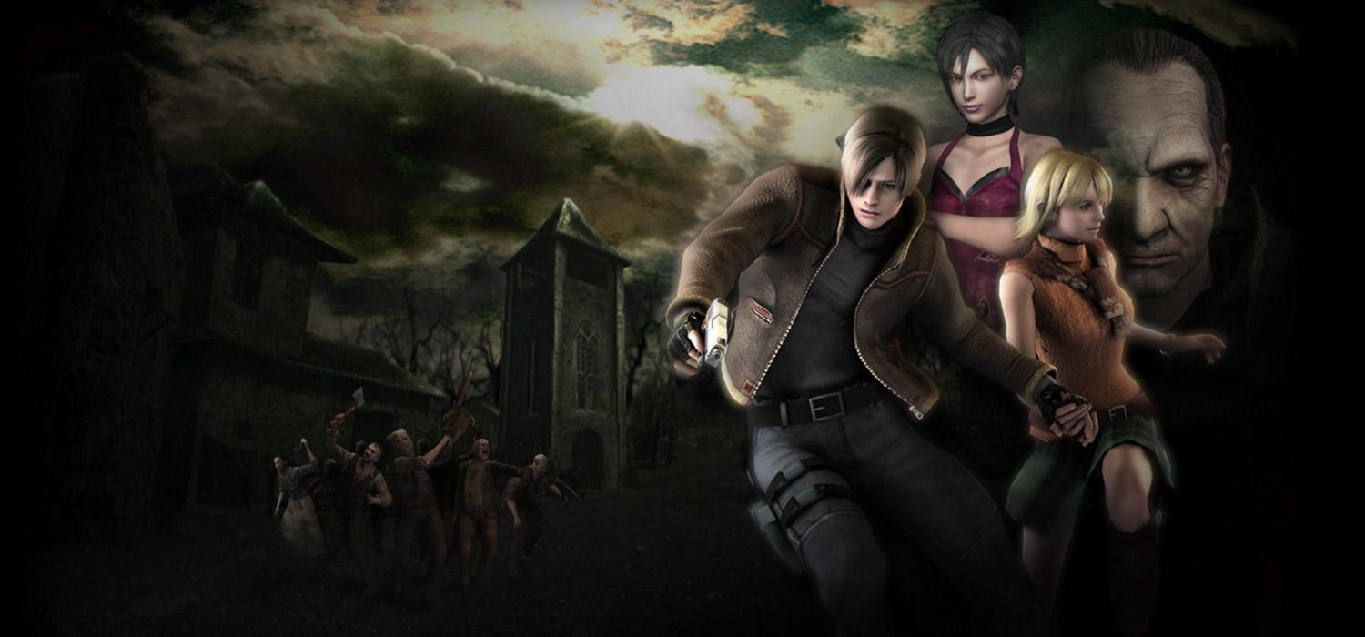
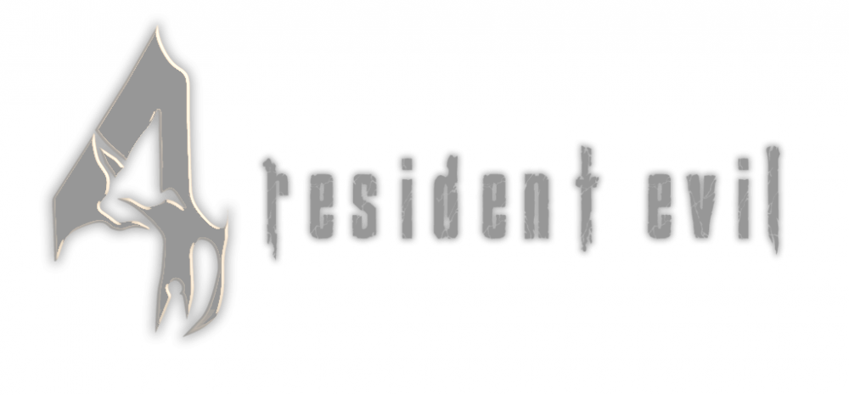
The Game That Pushed The Series In A Bold New Direction

Slide 2
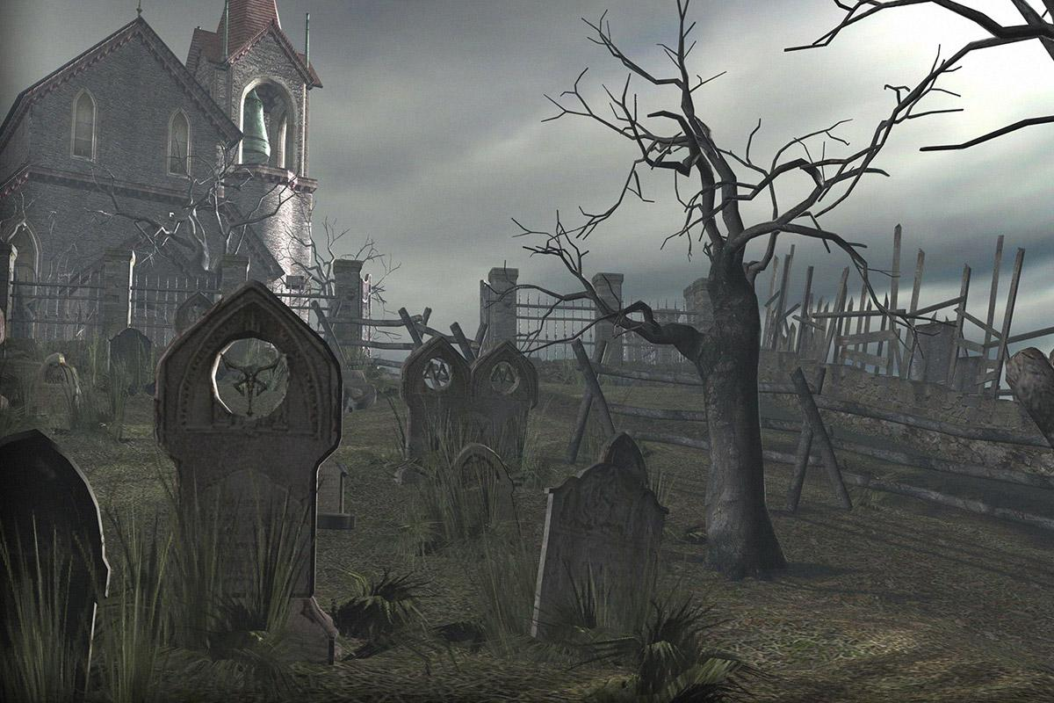
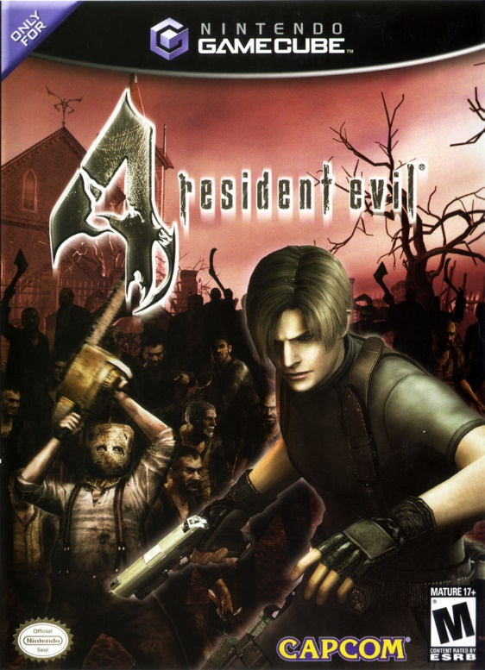

Introduction
RE4 is a survival-horror game developed by Capcom and released on January 11, 2005 as a timed exclusive for the GameCube console.
Development was directed by series creator Shinji Mikami.
RE4 went through a rough development cycle where 4 different versions were propsed (one of which became the prototype for the Devil May Cry Series)
The game was released on 12 different platforms and has sold a total of 8 million copies worldwide.
Won numerous Game of the Year awards upon release and is widely regarded by many as the single greatest third-person shooter of all time.

Slide 3
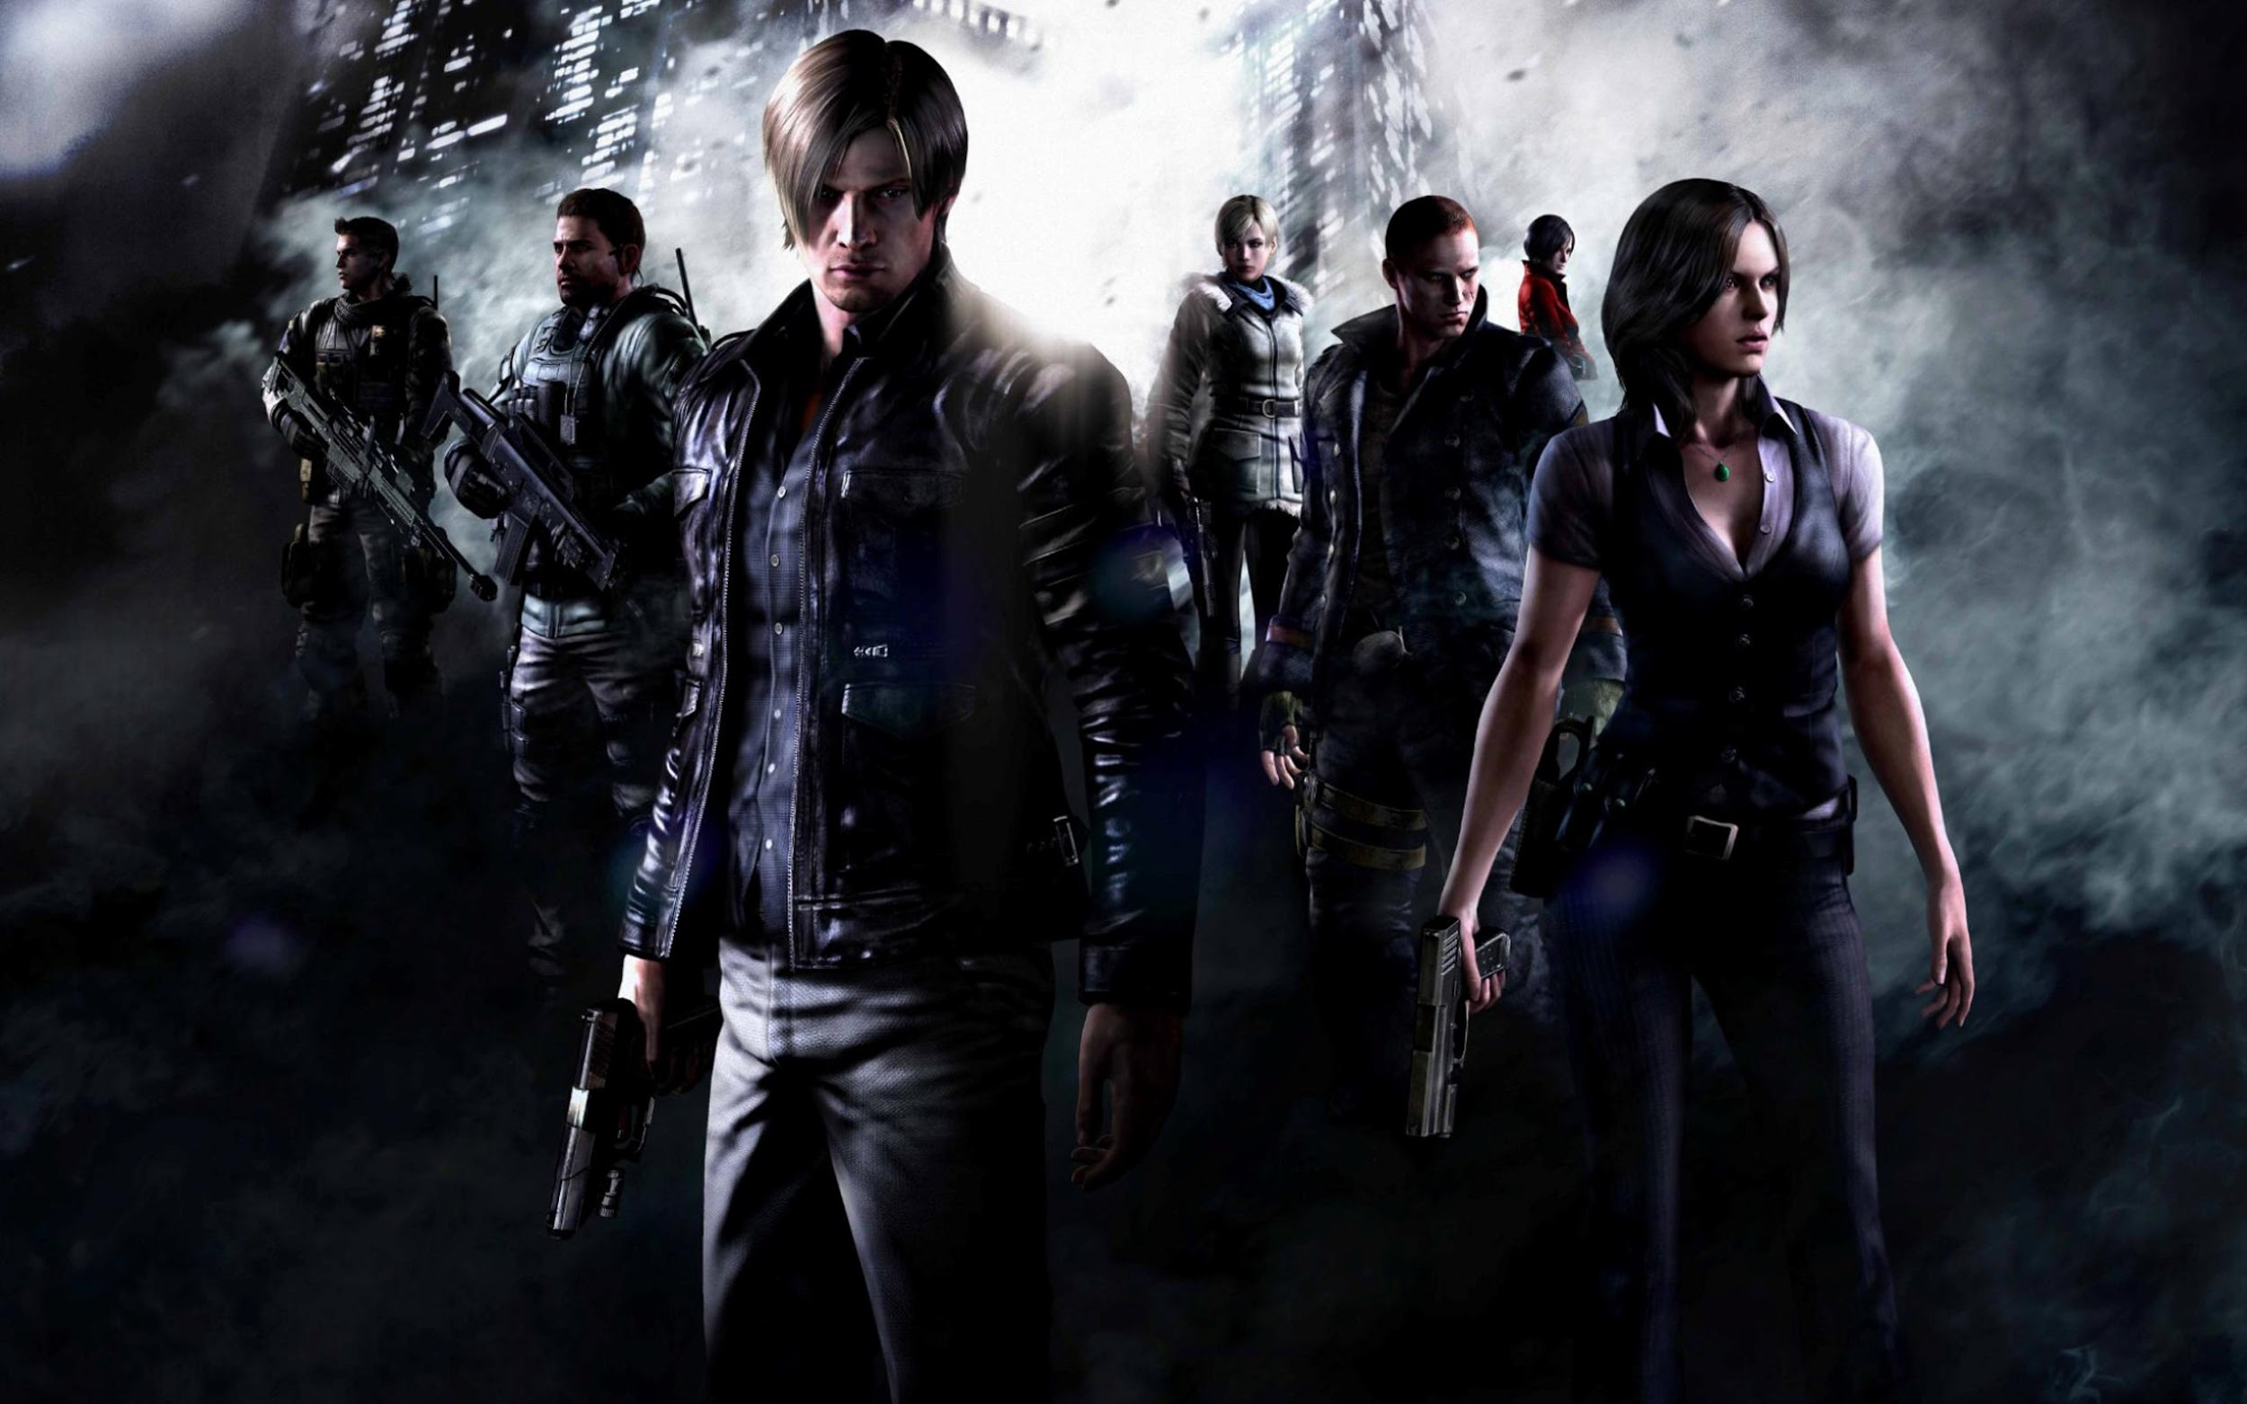
a
Resident Evil 4 pushed the series in a new direction by changing the camera, reinventing the enemies, and putting an emphasis on action over problem solving.

Slide 4
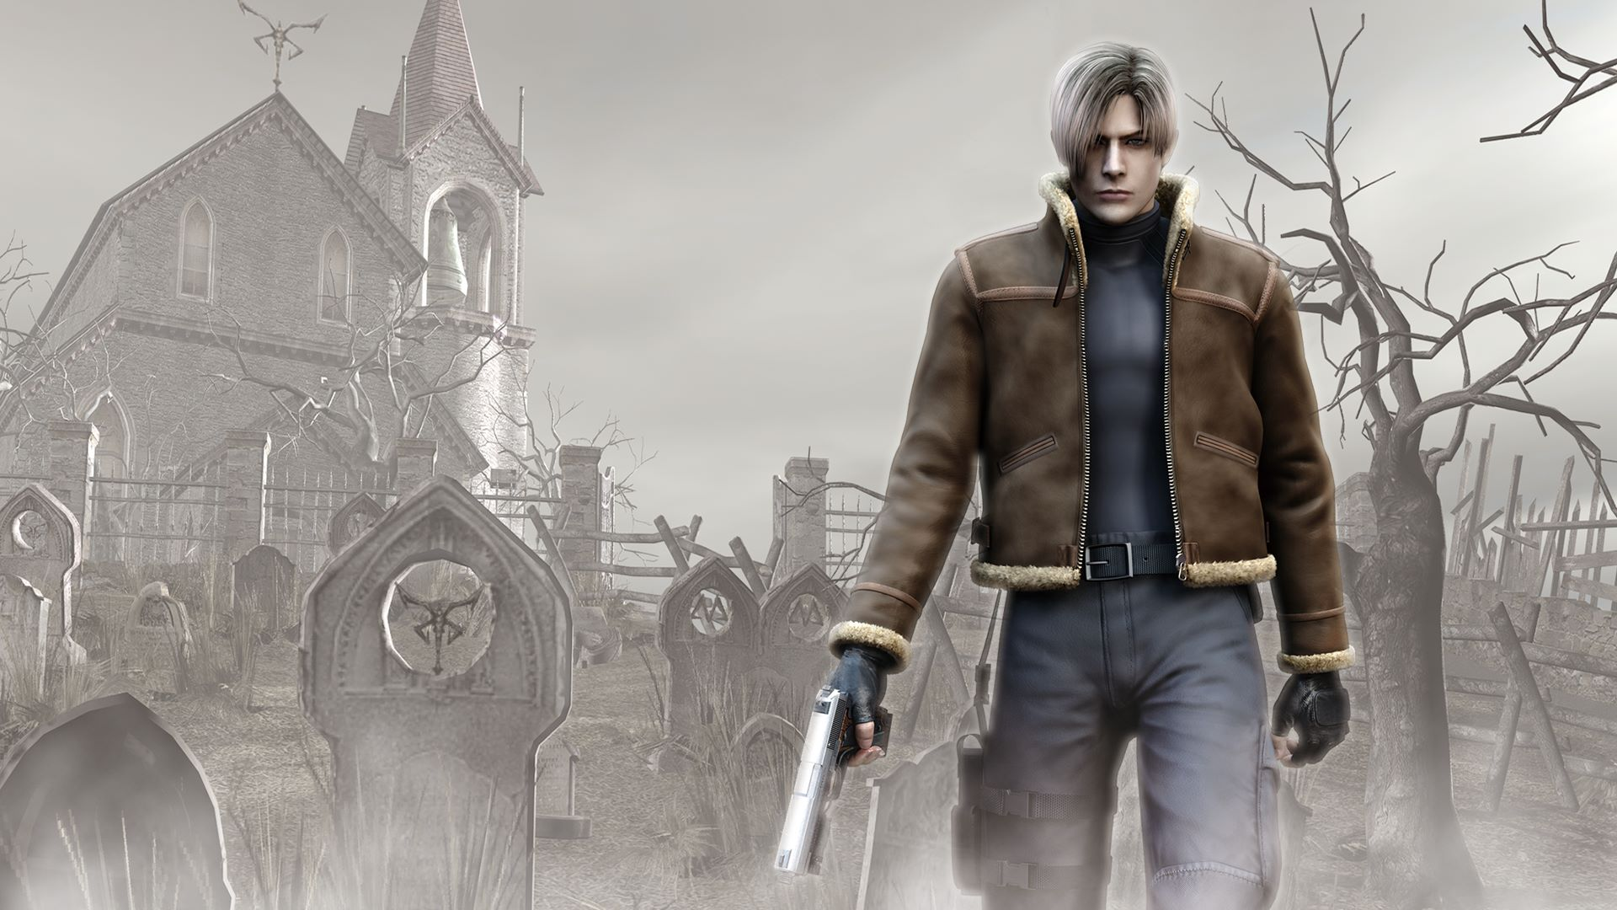
Argument 1: The Camera

Slide 5
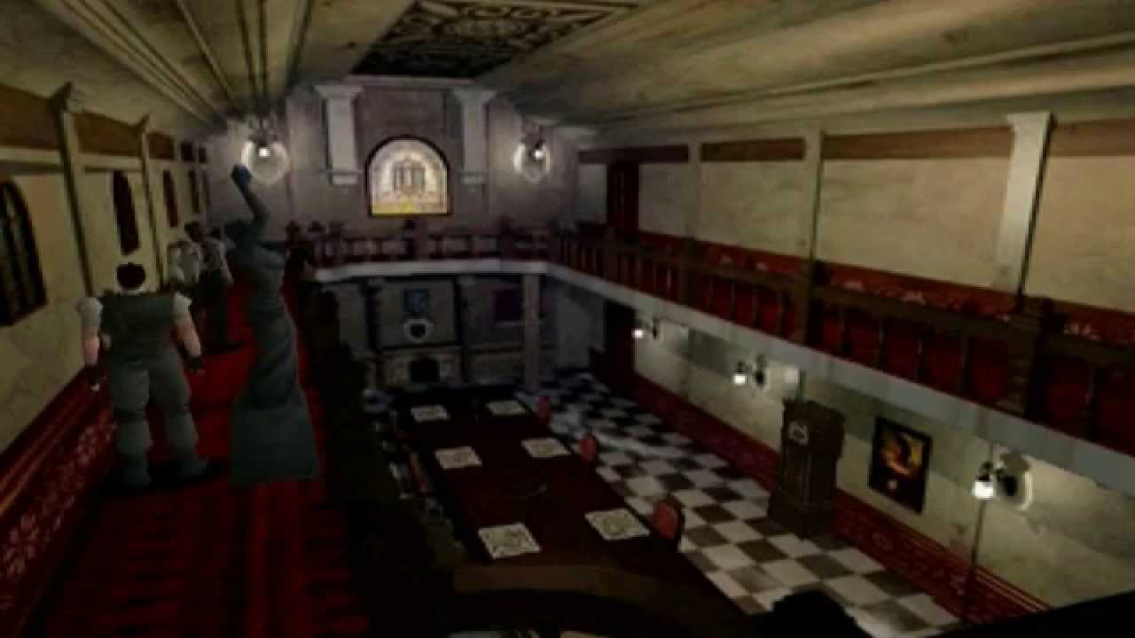
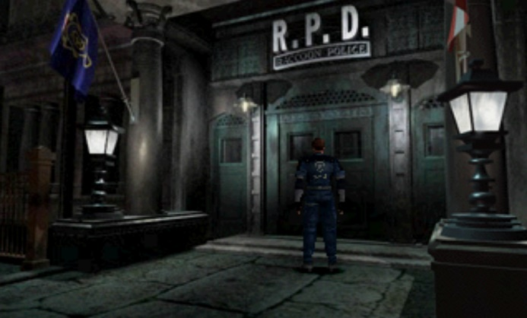
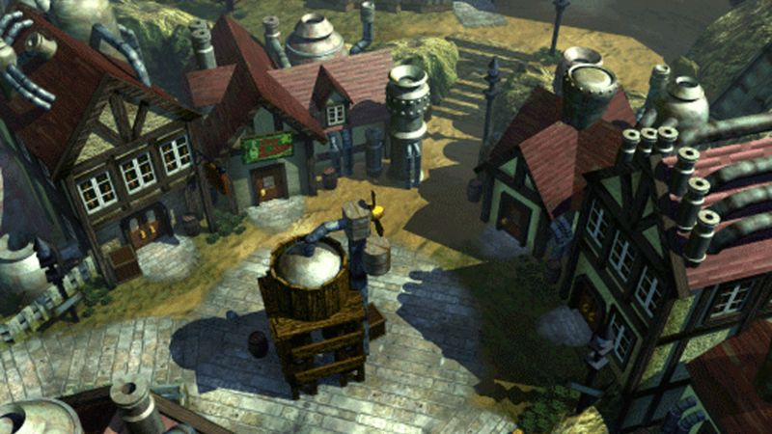
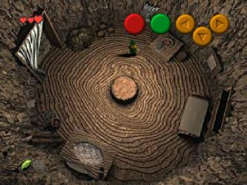
1.1 - Switching form Pre-rendered Backgrounds
Due to the hardware limitations of the 5th gen consoles, games could not render highly detailed environments in real-time 3D.
To fix this issue, many developers opted to use pre-rendered backgrounds. Level designers would paste rendered images of a 3D Scene from multiple fixed camera angles. They would then render the game characters and key items in front of the background in real time.
Collider objects would be programmed on top of items in the scene so that players could not pass through them. The camera angle would change to a different pre-rendered perspective based off of the player’s position.
Because of this, the camera would always stay still. The original Resident Evil game did not have a single in-game moment where the camera moved.

Slide 6
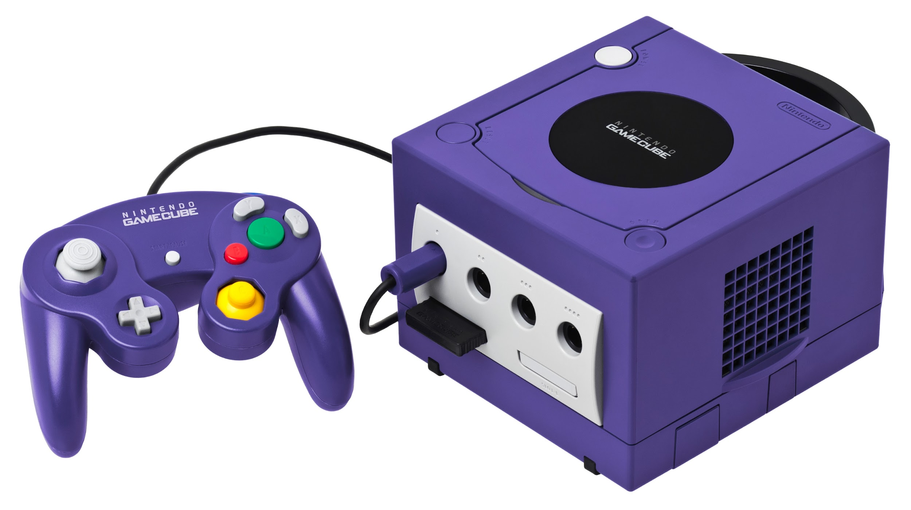

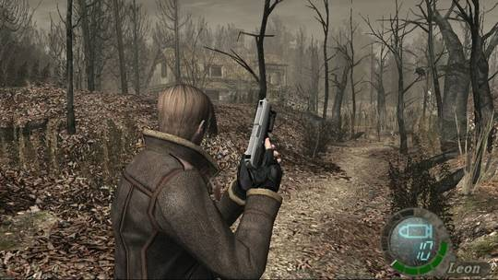
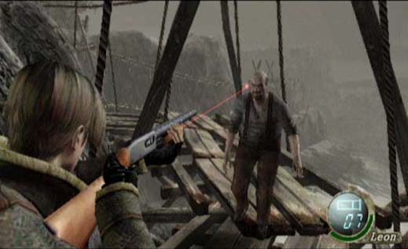
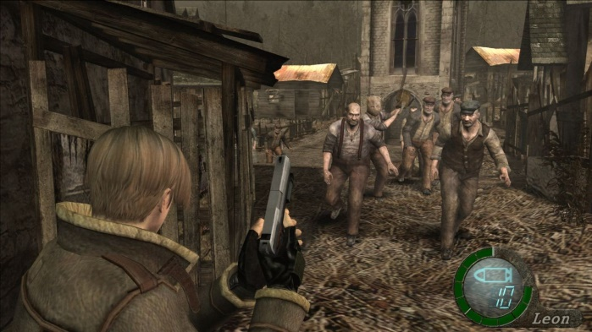
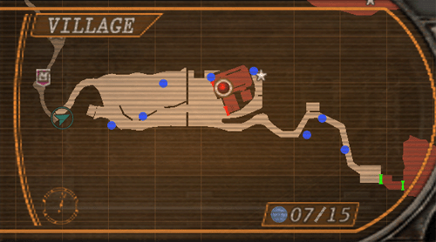
1.2 - The Move To Real-time Rendering
With the move to the ATI powered GameCube console, Capcom no longer needed to use pre-rendered backgrounds. The GC hardware was powerful enough to render entire levels in real time.
With this limitation removed, Capcom was able to switch the Camera from a fixed, still perspective to an active one that was always behind the player object. This switch came with many benefits:
  Player movement became more fluid. Rather than using the unconventional tank control scheme, player could now move in the direction of the analog stick.
  Players had more control over shooting their targets, allowing for more intended critical hits (like headshots).
  Levels could be designed in a way that implemented more exportability. Capcom used this to their advantage and implemented an blue medallion hunting system (which would have been impossible to do the original game)
  More enemies could fit on screen.

Slide 7

Argument 2: Reinventing the Enemies

Slide 8

2.1 – The Removal of Zombies
When this was first announced, Resident Evil fans were shocked. Capcom was taking a huge risk removing the enemy type that rose their series to fame.
The new enemy type was a group of Spanish villagers infected with the Las Plagas virus. These enemies were stronger, smarter, and more aggressive.
Unlike the mindless zombies that inhabited the first 3 Resident Evil Games, these enemies had intelligence and the ability to obey their masters.
This change was crucial to both the plot as well as the way that the game was designed.

Slide 9
2.2 – The Standard Infected Villager
These were the main enemy type that inhabited the game world.
Designed to be like pawns that could be killed off in mass numbers.
Unlike zombies, they were capable of using tools and weapons. They could also charge towards the player at full speed. This added a whole new level of tension to the game’s survival horror genre.
Programmed to have feedback loops. If the player killed many of them easily, the game would increase their AI difficulty and spawn more of them. Inversely, if they killed the player a lot, the game would lower their AI and spawn less of them.
  This AI mechanic was reiterated into series like Fallout, Skyrim and Dark Souls.
  Mark Brown video

Slide 10

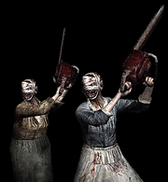


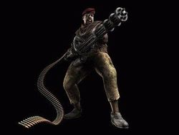

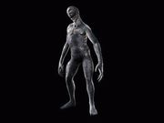
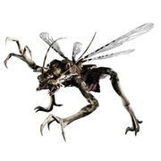
2.3 – Special Infected and Boss Battles
In addition to the standard villagers, Capcom also introduced a wide variety of specials Las Plagas infected enemies.
These enemies all had their own unique set of moves and attack patterns.
Some of them required special tactics and conditions to be defeated.
Capcom designed the game’s levels and encounters in ways that complimented the challenge of defeating these enemies.
  At first, only one would be introduced at a time, subtly teaching the player about the way their mechanics work.
  By the end of the game, the player is well-accustomed to their style and is fighting dozens of them at once.

Slide 11
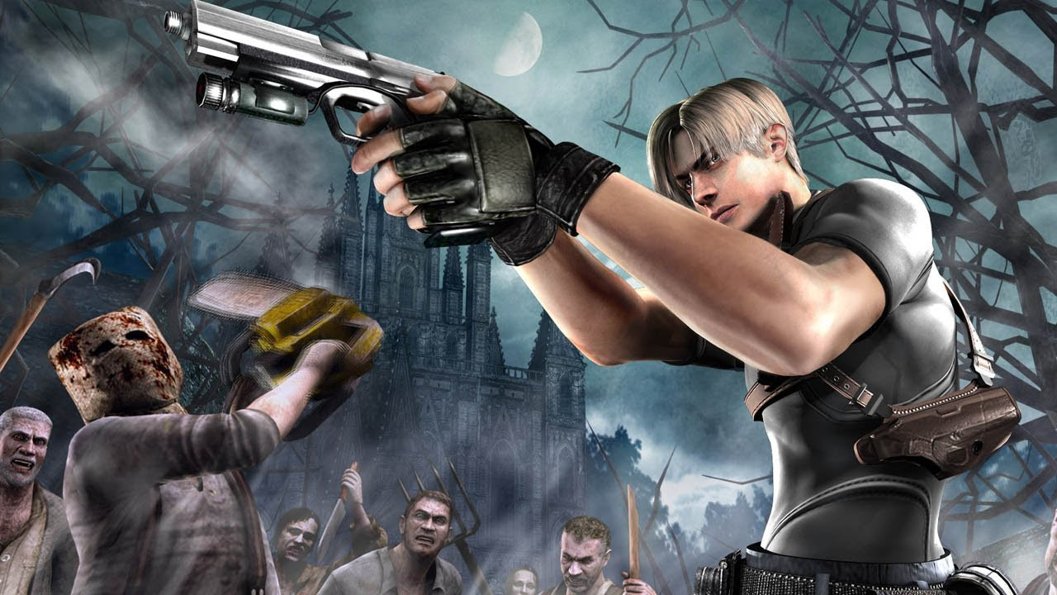
Argument 3: Emphasis On Action

Slide 12
3.1 – Understanding the Playstyle of Previous Entries.
The first 3 Resident Evil games had a different method of providing tense experiences.
This games were designed similarly to a point and click adventure. The main objective was to solve puzzles and search for key items to escape the mansion alive.
Death was a critical penalty. There were no checkpoints, and the player could only save a handful of times.
Enemy encounters were frightening because game would provide the player with barely enough resources to survive.
Landing a critical attack on an enemy was a result of probability as opposed to precision and finesse.
Many enemy encounters would end with running away. By the end of the game, the player would have only killed a few dozen enemies.

Slide 13
3.2 – Action, Guns and Shooting Mechanics
Resident Evil 4 replaced puzzle solving and escapism with action and shootouts.
Death as a penalty was reduced due to the introduction of auto-checkpoints (and enemy feedback loops)
Tension was more frequently experienced through audio, visuals, and from the scale of enemy encounters (however there were still scenarios where the player had limited resources)
The game contained over 20 different weapons and was far more generous with providing ammunition to the player.
The change in camera allowed for more controlled precision shooting and well-placed shots.
By the end of the game, the player has killed hundreds of enemies

Slide 14
3.3 – The Merchant
In addition to the new shooting mechanics, the game introd

